Slide 1

Applying Chaos Theory To The Dynamics Of Traffic Congestion
By Ashutosh Sundresh
Grade 12, Shiv Nadar school, Faridabad
Read the notes on each slide for more information

Slide 2
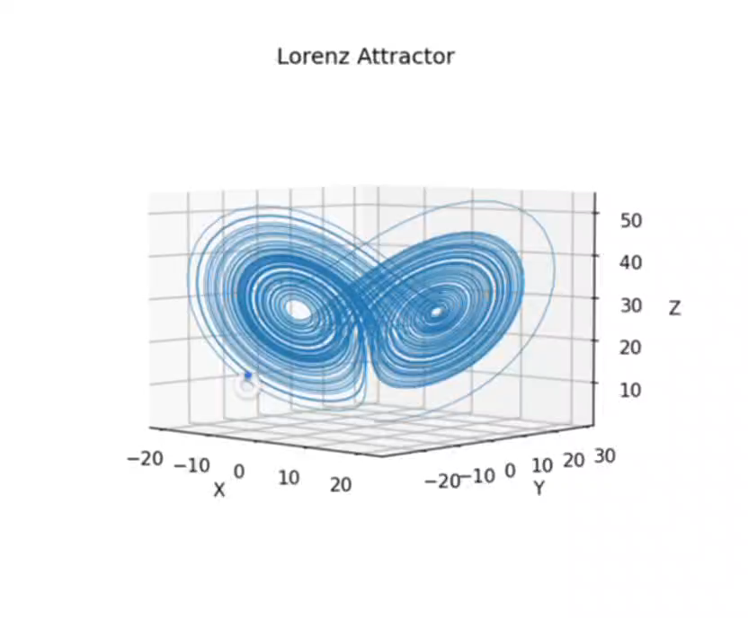
Introduction
The question that my research seeks to answer is “How can chaos theory be applied to understand and analyse the dynamics of traffic congestion, and what insights can be gained to mitigate and manage congestion in real-life scenarios?”
Chaos theory is a fundamental concept that describes the behavior of certain dynamic systems that are highly sensitive to initial conditions. Small changes in initial conditions → vastly different outcomes.
Traffic congestion is a significant issue in urban areas worldwide which has a dynamic nature, making it an ideal candidate for applying chaos theory to.
Notes:
The question that my research seeks to answer is how chaos theory can be applied to understand and analyse the dynamics of traffic congestion, and how these insights can be used to improve planning and improve congestion management in real-life scenarios. The principle used here is chaos theory, which is a mathematical discipline that unveils the deterministic nature underlying seemingly random and non-linear dynamical systems. It deals with nonlinear systems that exhibit sensitivity to initial conditions, resulting in unpredictable and intricate patterns of behaviour. A common example of this is Lorenz Attractor, the trajectory of which has been shown alongside. The Lorenz system is a set of three coupled ordinary differential equations that describe the evolution of three variables: x, y, and z. I’ve plotted the Lorenz attractor trajectory here using matplotlib in python. We clearly see that the trajectory of the system never repeats, meaning it does not settle into a fixed pattern or cycle. Additionally, Even a tiny change in the initial values of x, y, and z can lead to vastly different trajectories over time. This is a characteristic of chaotic systems.
Traffic congestion is a pervasive issue in urban areas worldwide, imposing significant economic, environmental, and social costs. It arises due to the intricate interplay of various factors, including vehicle flow, road capacity, traffic signal timings, driver behaviour, and external influences like weather conditions and events. The dynamic nature of traffic congestion makes it an ideal candidate for exploring chaos theory's potential to unveil hidden patterns and complexities.

Slide 3
Objectives
Objective 1 | Objective 2 | Objective 3 | Objective 4
To study traffic congestion data and find patterns that behave in a chaotic way. | To figure out the important factors and variables that create chaotic patterns in traffic congestion, so we can understand how the system works. | To predict traffic congestion patterns using chaos theory and learn how the traffic system reacts to outside influences. | To improve traffic management and congestion control strategies using chaos theory findings, making transportation more efficient and sustainable.
Notes:
There are 4 specific objectives with this research. The first is To investigate the application of chaos theory in the analysis of traffic congestion data, seeking patterns and structures indicative of chaotic behaviour.
The second is To identify key factors and variables that contribute to the emergence of chaotic patterns in traffic congestion, facilitating a deeper comprehension of the complex system dynamics.
The third is To explore how chaos theory can aid in predicting traffic congestion patterns and understanding the system's sensitivity to external influences.
The fourth is To assess the practical implications of chaos theory findings in traffic management and congestion control strategies, aiming to improve the efficiency and sustainability of transportation systems.

Slide 4

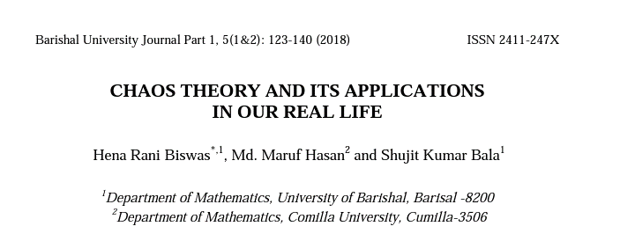

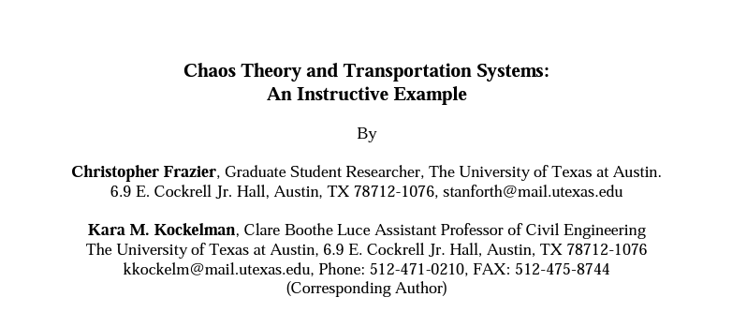

Literature Review
Notes:
There have been a few papers made in the early 2000s that touch upon the aspect of combination of traffic flow and chaos theory. The papers have already done extensive investigation on dynamic properties specifically on simulated traffic flow based on the car-following model and the distance between two cars. It has been found that there is a positive Lyapunov exponent (lupunov) indicating the existence of chaotic behaviour in transportation systems. The Lyapunov exponent measures the system's sensitivity to initial conditions, basically showing how closely related points in the system's state space diverge over time. One interesting concept related to chaos theory is the butterfly effect, which suggests that even minor disturbances, like a single driver slowing down or changing lanes unexpectedly, can trigger chain reactions leading to traffic jams or congestion. Furthermore, various mathematical models inspired by chaos theory, such as the cellular automaton model, have been developed to describe and predict traffic flow. The cellular automaton model represents vehicles as individual cells with specific movement rules, resulting in emergent traffic patterns.

Slide 5
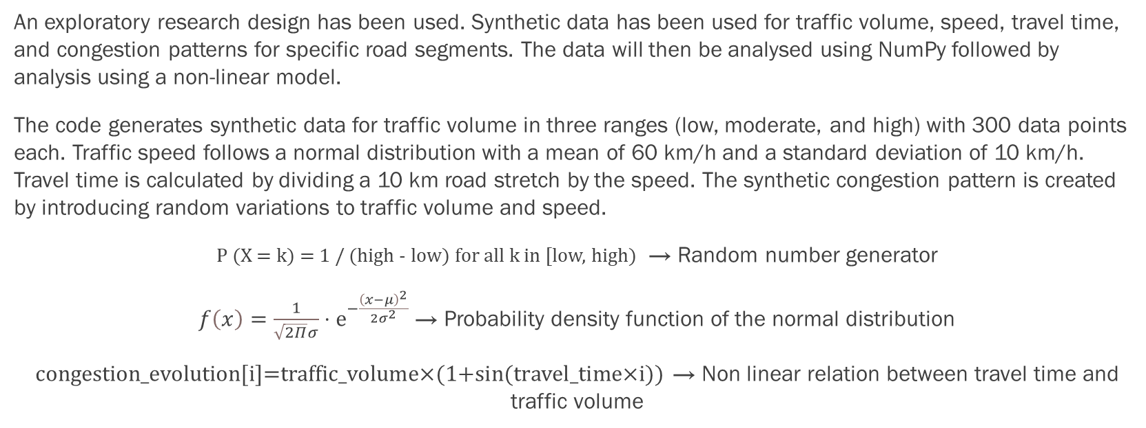
Methodology
An exploratory research design has been used. Synthetic data has been used for traffic volume, speed, travel time, and congestion patterns for specific road segments. The data will then be analysed using NumPy followed by analysis using a non-linear model.
The code generates synthetic data for traffic volume in three ranges (low, moderate, and high) with 300 data points each. Traffic speed follows a normal distribution with a mean of 60 km/h and a standard deviation of 10 km/h. Travel time is calculated by dividing a 10 km road stretch by the speed. The synthetic congestion pattern is created by introducing random variations to traffic volume and speed.
P (X = k) = 1 / (high - low) for all k in [low, high) → Random number generator
$f\left(x\right)=\frac{1}{\sqrt{2Π}σ}⋅ⅇ^{−\frac{{\left(x−μ\right)}^{2}}{2σ^{2}}}$ → Probability density function of the normal distribution
congestion_evolution[i]=traffic_volume×(1+sin(travel_time×i)) → Non linear relation between travel time and traffic volume
Notes:
This study uses an exploratory research design to investigate the relationship between chaos theory and traffic congestion. Due to the lack of readily available traffic data, synthetic data is utilized. Statistical analysis software like Python with NumPy libraries processes the collected traffic data, and a non-linear model is applied for further analysis. Chaotic behavior indicators are used to understand chaotic dynamics in traffic congestion.
Regarding data synthesis, traffic volume is divided into three ranges: low, moderate, and high, each containing 300 synthetic data points randomly generated within specific ranges. Traffic speed is assumed to follow a normal distribution with a mean of 60 km/h and a standard deviation of 10 km/h, resulting in 900 synthetic data points. Travel time is derived by dividing the distance of 10 kilometers by the corresponding speed.
To simulate peak hour traffic congestion, synthetic congestion patterns are generated by introducing random variations to traffic volume and speed. This replicates the increase in traffic volume and decrease in average speed during peak hours.
Here we have three different equations that have been used as part of functions in the Python code. The first is a random number generator. A discrete uniform distribution assigns equal probabilities to all the integers in the specified range where one is picked randomly. In the next definition of a probability density function, μ is the mean and σ is the standard deviation. Finally, there is the non linear relation between travel time and traffic volume. The presence of the sine function introduces non-linearity to the model, as the congestion evolution depends on both traffic volume and travel time (which, in turn, depends on speed). There is a combination of determinism (through the equation, which means that the future behavior is determined by the current state) and randomness (through the random variations) which can lead to chaotic behavior, where the evolution of congestion becomes difficult to predict precisely.

Slide 6

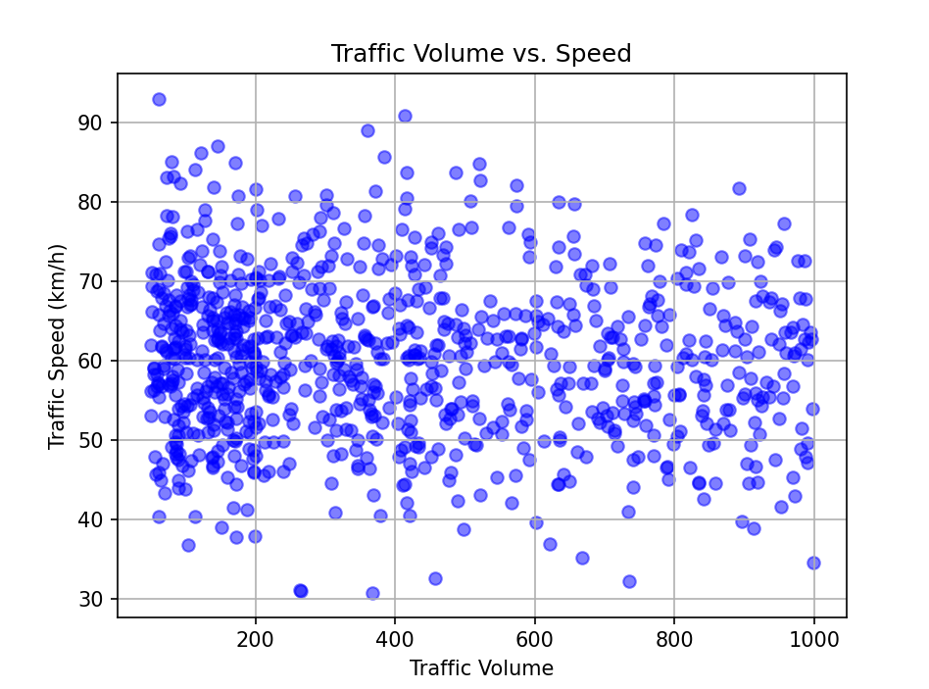
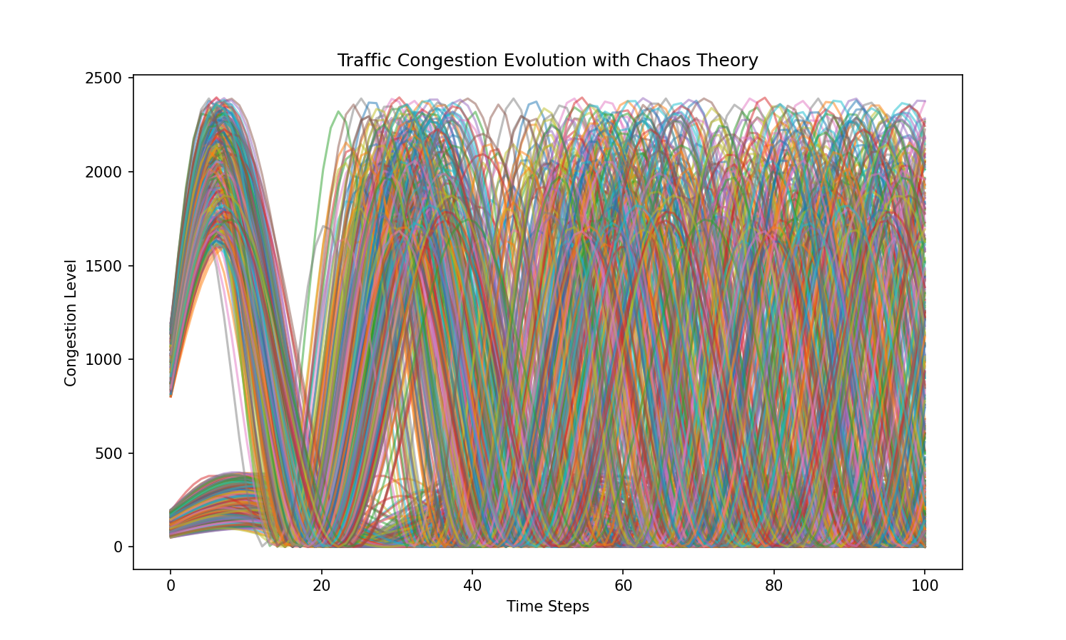
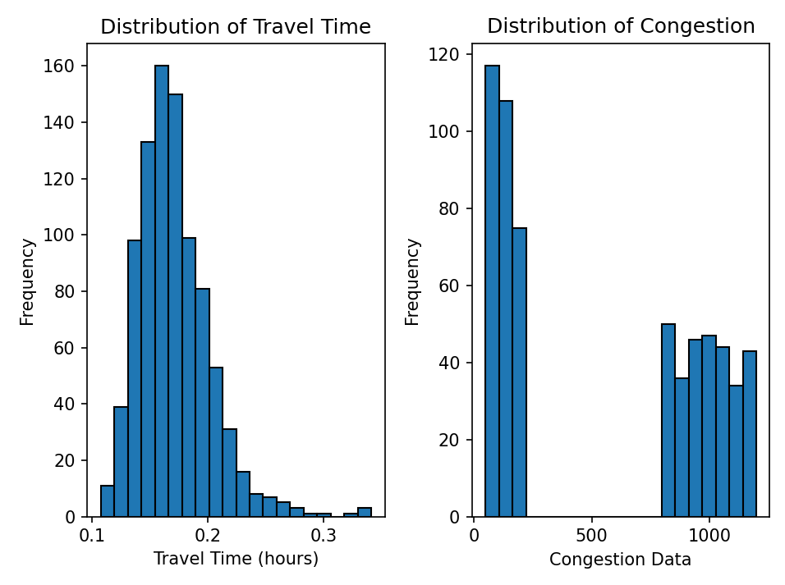
Results and Analysis
Analysis has been included in the notes
Notes:
Traffic volume and congestion data are measured using volume per hour, travel time is measured in hours, and distance is measured in kilometres. The mean and standard deviation for different parameters in a certain synthetic set have been shown above. Let us now take a look at each of the graphs individually. Clearly, it is seen that traffic speed and traffic volume have no clear pattern and are heavily scattered. There is an apparent concentration at low volume and speed of around 60 kmph, where 60 kmph was defined as the mean speed and volume changes based on the time of day, by introducing random changes based on whether it is peak hour. The heavily scattered and no clear pattern in traffic volume and speed indicate the complex and dynamic nature of traffic flow. The concentration of synthetic travel times around a particular value indicates a typical or average travel time for the road segment under normal traffic conditions. However, chaos theory shows that small perturbations in traffic volume and speed can cause deviations from the average travel time. The histogram of congestion data on the other hand shows a skewed distribution, with a large gap and a tail extending to the right. Higher congestion values tend to be associated with longer travel times. Finally, for the traffic congestion evolution simulation, non-linear behaviour is exhibited, as evident from the sinusoidal shape of the lines. This is because of the use of a non-linear function to model the congestion dynamics. It demonstrates how small variations in traffic volume and speed can lead to significantly different congestion levels over time.

Slide 7
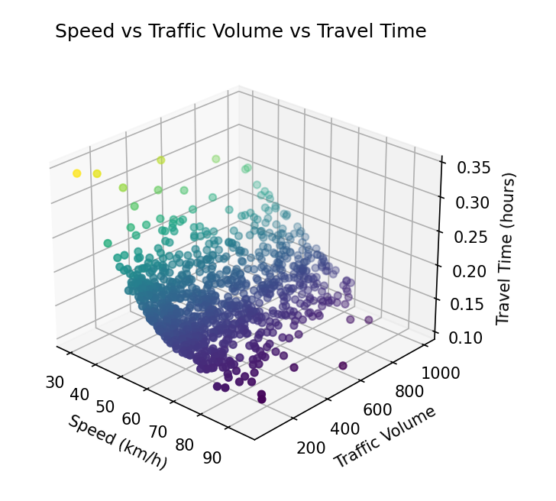
Conclusion
Chaos theory applied to traffic congestion modeling reveals the intricate and dynamic nature of traffic flow. By visualizing congestion evolution for different scenarios, we observe how small changes in traffic volume and speed lead to significant variations due to non-linear dynamics. City planning can benefit from understanding non-linear relationships to optimize transportation systems, reduce congestion, and improve overall mobility.
In the provided simulation at the end, the congestion evolution is determined by the traffic volume and speed data. Random variations in traffic volume and speed during peak hours introduce an element of randomness.
Notes:
Chaos theory provides a powerful framework to analyze traffic congestion. The generated plots provide insightful visualizations of how traffic congestion evolves over time under different scenarios. These plots demonstrate that even slight changes in traffic volume and speed can have a profound impact on congestion levels. Furthermore, the non-linear dynamics exhibited in the traffic congestion models indicate that the relationship between traffic volume, speed, and congestion is not straightforward or proportional. Instead, it involves intricate interactions and feedback loops, resulting in complex and sometimes unpredictable traffic patterns. The insights gained from chaos theory-based traffic congestion modeling can have significant implications for city planning.

Slide 8


Implications
Non-linear functions in traffic congestion modelling can be a powerful tool not only in traffic engineering but also in various fields like meteorology, ecology and economics.
Applying chaos theory principles to traffic congestion provides a real-world application and further validates the relevance and importance of chaos theory in various fields.
The findings can contribute to the development of intelligent transportation systems, including traffic signal control algorithms and adaptive routing systems, which can dynamically respond to changing traffic conditions.
Notes:
Let us take a look at the implications of this work. Beyond traffic engineering, the use of non-linear functions can extend to various fields like meteorology, ecology, and economics. These disciplines often deal with complex systems where non-linear relationships exist. For example, In meteorology, non-linear modeling can help predict and analyze weather patterns and climate phenomena. Chaos theory deals with complex and deterministic systems that exhibit sensitivity to initial conditions and non-linear dynamics. By identifying chaotic behavior in traffic congestion, it not only deepens our understanding of transportation systems but also reinforces the importance of chaos theory in diverse scientific fields. Additionally, The findings derived from chaos theory analysis in traffic congestion can significantly contribute to the development of intelligent transportation systems .

Slide 9
Future Work
The synthetic data used in this example might not fully represent the complexity and variability of real-world traffic data, potentially limiting the generalizability of the results. Collecting and integrating real-world traffic data from multiple sources to create a more accurate and comprehensive traffic congestion model could be a good idea.
The simplicity of the non-linear function used for congestion simulation may not capture all real-world traffic dynamics and may require more sophisticated models for accurate predictions.
Extend the model to consider different transportation modes (e.g., cars, buses, bicycles) and their interactions, as well as multimodal traffic systems to better represent complex urban traffic dynamics.
Examine the environmental impact of traffic congestion, such as greenhouse gas emissions and energy consumption, to aid in sustainable transportation planning.
Notes:
The synthetic data used in the code might not fully capture the complexity and variability of real-world traffic conditions. Real traffic data from various locations and scenarios would provide more accurate and representative results. This can be obtained from sensors, GPS data from vehicles, and other relevant sources.
The code's model of traffic congestion is relatively simplistic, considering only traffic volume, speed, and a sinusoidal function to represent congestion dynamics. Real-world traffic congestion involves a wide array of factors, such as driver behavior, road conditions, weather, and traffic signal timings, which are not fully considered in this example.

Slide 10
Acknowledgments
I express my gratitude to the authors Hui Fu, Jianmin Xu and Lunhui Xu for giving me the idea of using simulated datasets representing traffic congestion when secondary sources were not easily findable (they used a similar approach by creating a simulated traffic flow with a car-following model).
I additionally express my gratitude to the authors Zhongli, Jin Bae Park, Guanrongchen and Young Hoon Joo for the idea of using a sinusoidal nonlinearity to generate chaos.
Additional notes: All the code, simulations and graphs used in the project are open-source and I’ve published the repository at https://github.com/fireambulance/SinusoidalGraphsAndSyntheticTrafficData on GitHub.

Slide 11
References
Christopher Frazier, & Kara M. Kockelman “Chaos Theory and Transportation Systems: An Instructive Example.” Transportation Research Record No.1897: 9-17 (2004)
John E. Disbro, & Michael Frame “Traffic Flow Theory and Chaotic Behaviour.” Transportation Research Record No.1225: 109-115 (1989)
Aderemi Adewumi, Jimmy Kagamba, & Alex Alochukwu “Prediction of Motorised Traffic Flows on Urban Networks.” Hindawi ID 5656734 (2016)
Hena Rani Biswas, Md. Maruf Hasan, & Shujit Kumar Bala “Chaos Theory and Its Applications in Our Real Life.” Barishal University Journal Part 1, 5 (1&2): 123-140 (2018)
Steven H. Strogatz “Nonlinear Dynamics and Chaos.” (2015)
Meng Hui, Lin Bai, YanBo Li, & QiSheng Wu “Highway Traffic Flow Nonlinear Character Analysis and Prediction.” Hindawi ID 902191 (2015)
Adam Clarridge, & Kai Salomaa “Analysis of a cellular automaton model for car traffic with a slow-to-stop rule.” Theoretical Computer Science 411 3507-3515 (2010)
Hui Fu, Jianmin Xu, & Lunhui Xu “Traffic chaos and its prediction based on a nonlinear car-following mode.” Journal of Control Theory and Applications 302-307 (2005)
Zhongli, Jin Bae Park, Guanrongchen, & Young Hoon Joo “Generating Chaos Via Feedback Control From A Stable Ts Fuzzy System Through A Sinusoidal Nonlinearity.” International Journal of Bifurcation and Chaos 12(10) (2011)

